Slide 1



React Overview

Slide 2




What is React?
•
React is a library for building modern single-page applications
Official docs Tutorials
www.reactjs.org

Slide 3

How is Single-Page application different than
Traditional application?

Slide 4


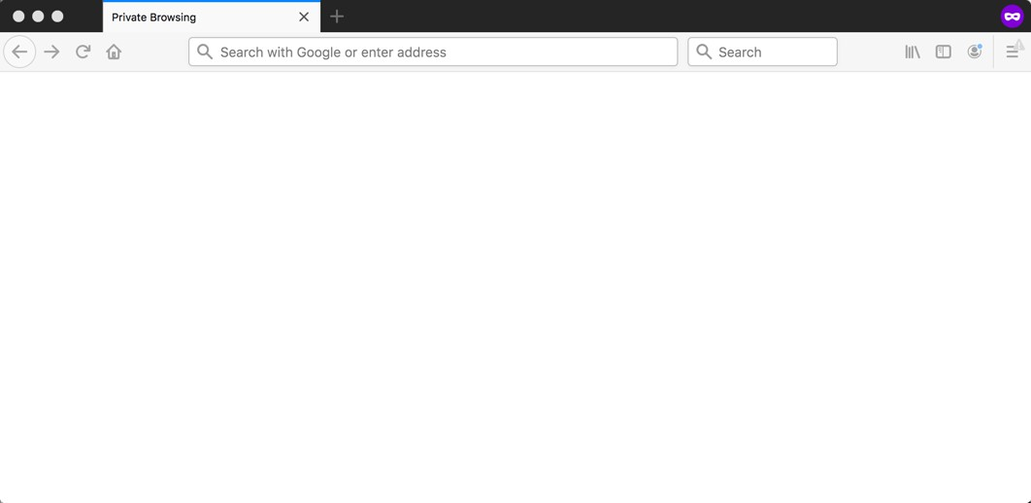

Traditional Application
Each user action results in a full HTML page load
Full HTML Page Loads
Server

Slide 5
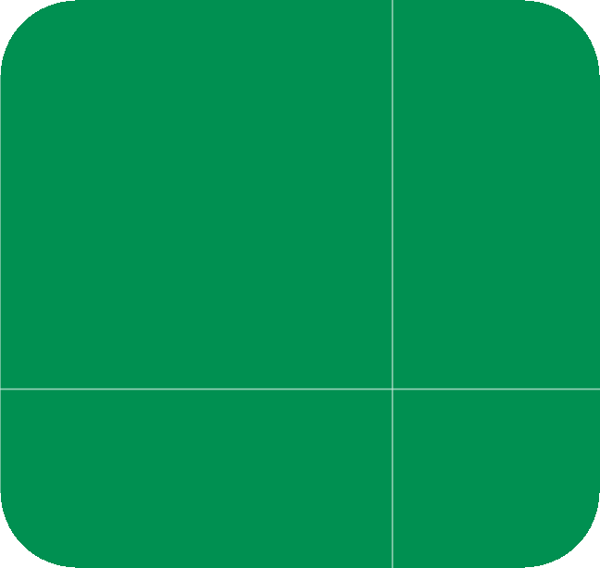
Single-Page Application
A web application that is composed of a single page
Based on user actions, the application page is updated
Normally performs a partial update … instead of full page load
Partial page updates
(client side only)
REST API for data
Server

Slide 6

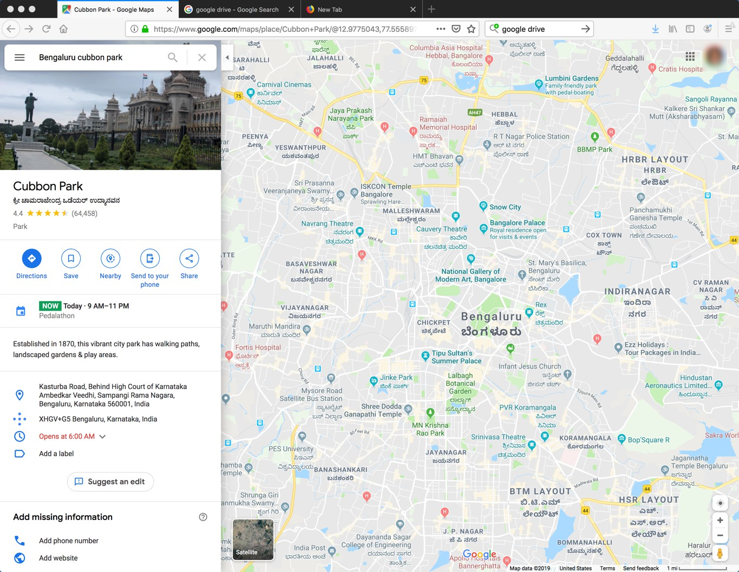

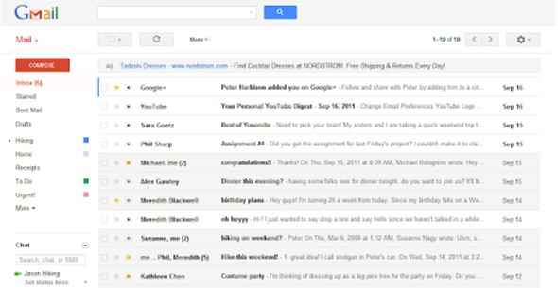
Examples of Single-Page Applications
Maps
Email

Slide 7
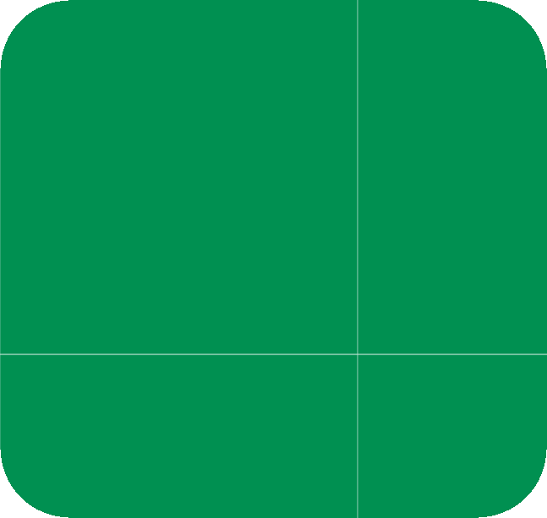
React Solution
•
React is a library for building modern single-page applications
Partial page updates
(client side only)
REST API for data
Server

Slide 8



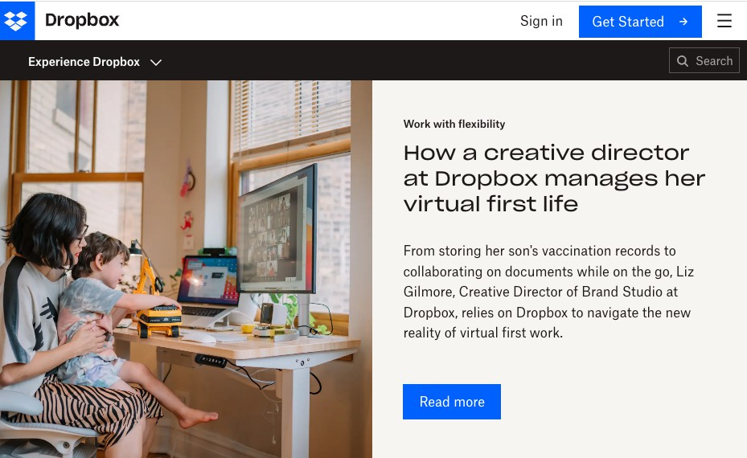
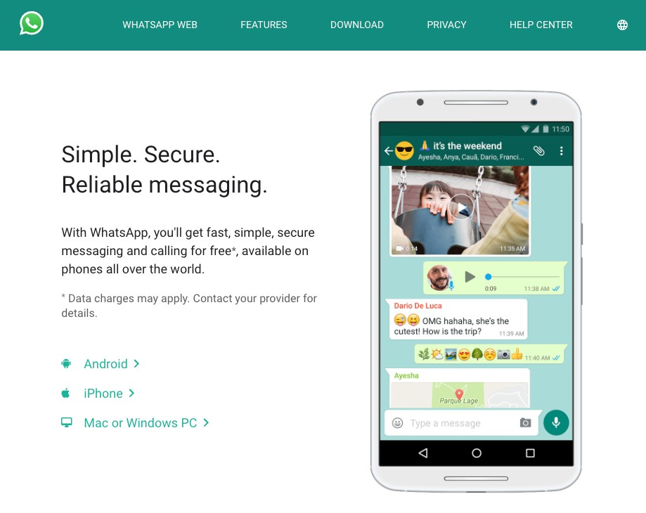
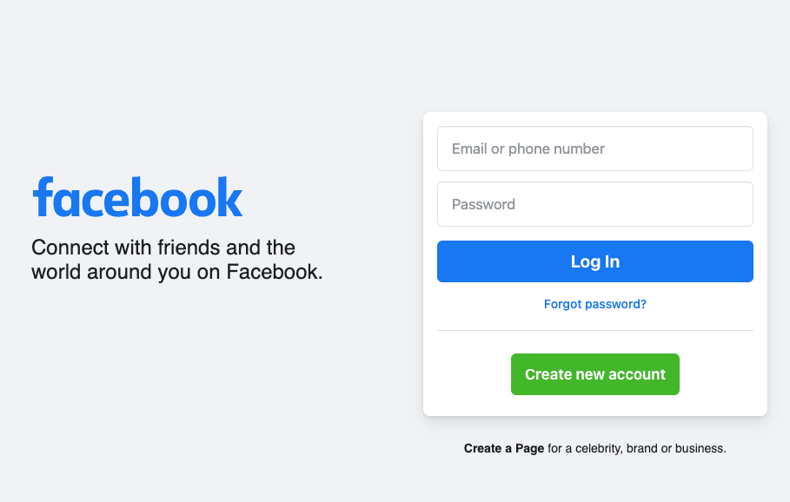
Who’s using React
Companies around the world are using React
Dropbox
WhatsApp
Facebook
www.https://madewithreactjs.com

Slide 9

React History
React 0.3.0 (Release)
React 0.10.0
React 0.13
React 0.14
React 15
React 16
React 17
React 18
2013
May
2014
March
2015
March
2015
October
2016
April
2017
September
2020
October
2022
March
Major release every few years

Slide 10
What about Do-it-Yourself?
FAQ: Couldn't I just do it myself with JavaScript, jQuery, AJAX etc?
•
May work for small basic hobby apps
•
For common features such as data binding, you may reinvent the wheel
•
Hard to manage and maintain for enterprise real-time applications
•
Main reason we have libraries & frameworks such React.js, Angular, Vue.js,
…

